Slide 1
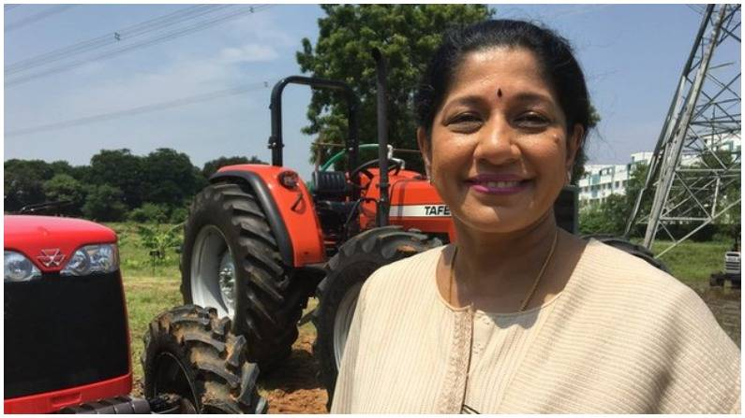

Mallika Srinivasan
google images
Jukkalkar Syed Imtiaz
Shri Shivaji Science And Arts College, Chikhli

Slide 2
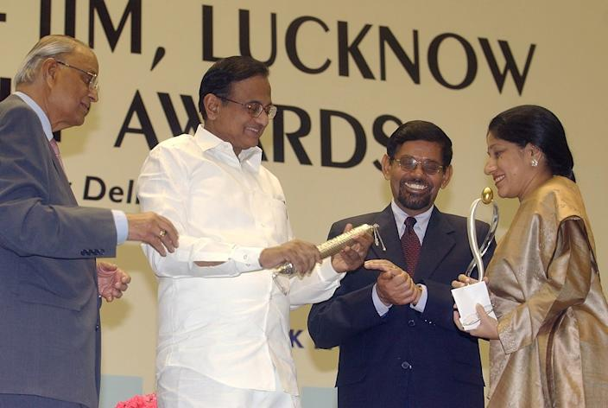
Mallika Srinivasan
google images
Mallika Srinivasan is an Indian industrialist who currently acts as the Chief Executive Officer of Tractors and Farm Equipment (TAFE).
She is recipient of several awards including the First Business Woman Award from BBC.
Business Woman of the Year, by Economic Times
Entrepreneur of the Year Award in the field of Manufacturing by Ernst & Young
Tractor Queen by the Members of the Media.
The media ranked her as one of India’s most powerful women.

Slide 3
Family and Educational Background
Econometrics: Econometrics is the use of statistical methods using quantitative data to develop theories or test existing hypotheses in economics or finance.
Born on 1959, she grew up listening to her father discussing business at dinner table.
The attitude of her father taught a lot, shaping her into an industrialist.
In school she did well, showing keen interest in business and economic principles.
Her father suggested her to study literature but she opposed the idea.
She pursued an M. A. Econometrics from Madras University.
During that period she got married to Venu Srinivasan, chairman of the motorcycle manufacturer TVS Motor Company.
However, Mallika was not content, she decided to study abroad.
Mallika decided to do her MBA at Wharton School, in the University of Pennsylvania. It was a significant decision, considering she had an infant daughter to take care of.
Her mother supported her decision and accompanied her to America, so that she could take care of her grand daughter.
With her mother’s help, she could complete her MBA.

Slide 4
Her studies in Wharton did not impress her father or his employees.
Her father said, “Listen young lady, you might be a Wharton graduate, but I don’t need one to run my business.”
In the year 1986, she joined her family business, TAFE, one of her father’s high profile companies.
Her father made it clear that she has to earn her keep.
She had anticipated a grand acknowledgement of her joining company, but was disappointed as she discovered that her father had set her office at the end of a corridor without proper ventilation.
Her father explained that he had managed the company and seen it expand since his father founded the company, and he had done all this without a degree. Her studies in Wharton did not impress him or his employees, and he did not fail to remind her of this fact.

Slide 5
Disillusioned but not disheartened
She had used the strong words of her father as inspiration.
She began to use her knowledge to good use and as the company began to grow, she settled on a million dollar target.
As time passed her responsibilities increased and her father showed more and more trust in her abilities.
She began to make TAFE, number one company, the first choice of farmers.
In 1960, the company was founded, at that time the quota of the company was 7000 tractors a year, and in 2012 the company was able to make 7000 tractors in fifteen days. The turnover in 1985, when Mallika joined was Rs, 86 crores, by 2010 the turnover increased to 5800 crores. This was due to the efficiency of Mallika Srinivasan.
Disillusioned but not disheartened, Mallika continued to work in her family business.
She learned lessons from more senior and experienced colleagues, and she picked up several tricks of the trade.
The colleagues did not pussyfoot around her because they had known since she was a little girl.
All the employees treated her with sincerity and sympathy, allowed her to recognize mistakes she was making, and to appreciate the position she was making.
She began to put her knowledge to good use as the company began to grow.

Slide 6
Effective Decisions
She also made export a key part of TAFE’s strategies.
She set up a manufacturing plant in Turkey in 2010 to increase TAFE’s market and customers.
She began to increase plants to supply tractors to African countries also.
Further she strengthened TAFE with its tie up with Agco Corp, a Georgia-based farm equipment maker, for distribution in the US. It was no surprise that in 2012 she own a leadership award for designing and developing farm equipment relevant to Indian farmers, and for taking TAFE all the way to the top.
One such big decision was acquisition of Eicher Motors in 2005, which thrust TAFE into the number two spot in the country.
Even during times of economic downturn, Mallika Srinivasan, made decisions that were beneficial to the company.
When sales began falling, she insisted the company to prioritise research and development so that when the market recovered, new models could roll out and challenge their competitors’ products.
It was successful initiative leading to TAFE recording a profit that year when most companies could not.

Slide 7
Mallika experienced major trials
Mallika experienced major trials during company’s explosive growth. In the late 2000s her father passed away. He had been her anchor and her rock guiding her in the right direction.
Months after her father’s death, her sister passed away. Two major losses within her family and she still was able to steer the company professionally without letting her personal grief overwhelm her professional responsibilities.
And then in 2008, her mother left for heavenly abode. Mallika had lost her family. But yet she managed. The way in which she managed the company during that period was a source of inspiration for many of her employees.

